Slide 1

Notes:
https://drleespine.com.au/cervical-disc-replacement/

Slide 2
Agenda Overview
The Need
The Significance
Our Solution
Product Specifications Summary
Market Analysis Summary and Proposed Business Model
Proposed Regulatory and Reimbursement Strategy
Future R&D Directions
Conclusion

Slide 3
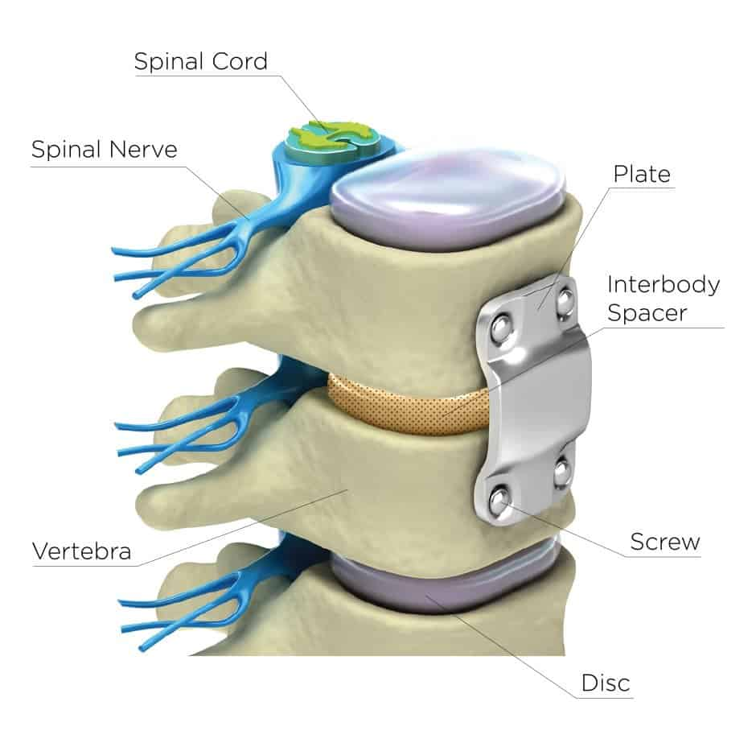
Disease State Fundamentals
Anterior cervical discectomy and fusion (ACDF) and anterior cervical disc replacement (ACDR) are two common spinal surgeries to treat cervical radiculopathy
As part of this surgery, tissues (muscle, esophagus, trachea, etc.) are retracted to access the spine itself
In some cases, patients report dysphonia and dysphagia post-surgically
No single source has been identified that causes these problems, but some hypothesize that the force exerted on the retracted tissues causes this injury

Slide 4
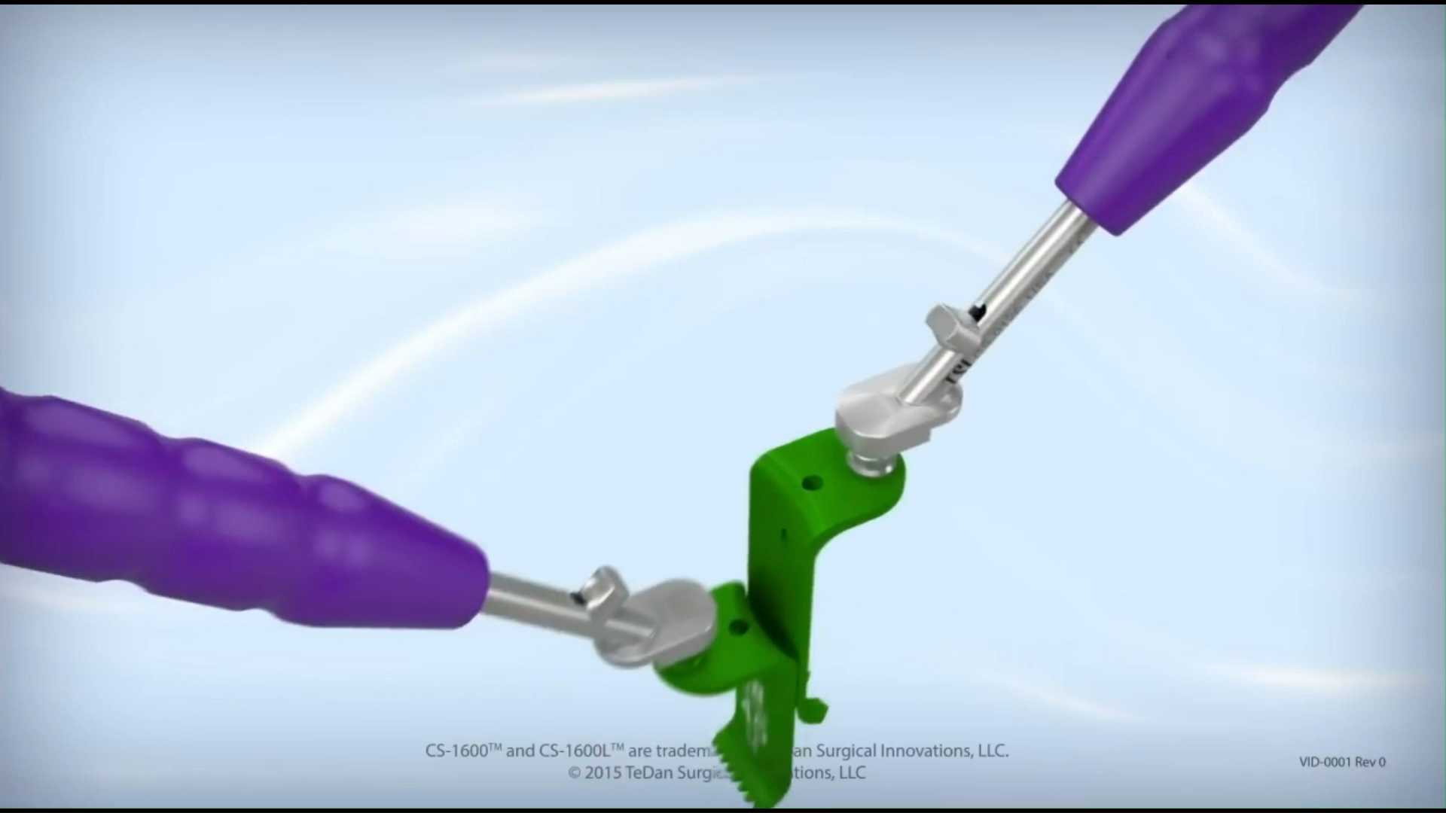

Slide 5
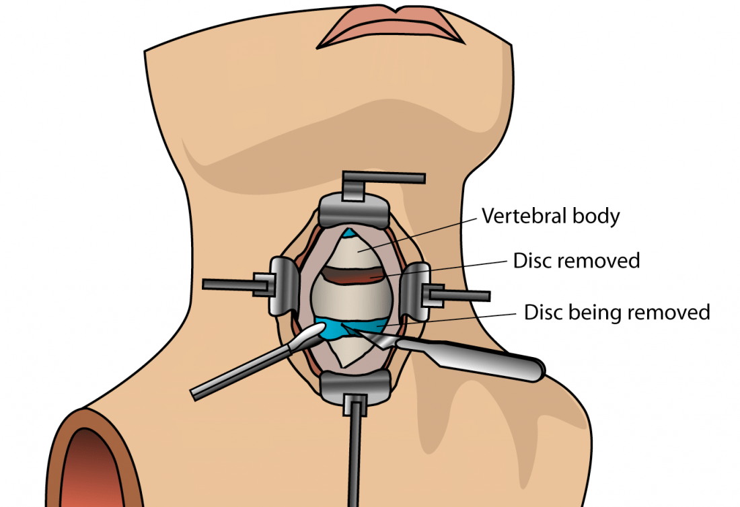
Needs Statement
There is a need for a way to provide real-time monitoring of tissue pressure during anterior cervical spine surgery to minimize soft-tissue injury and postoperative complications from the surgery.

Slide 6
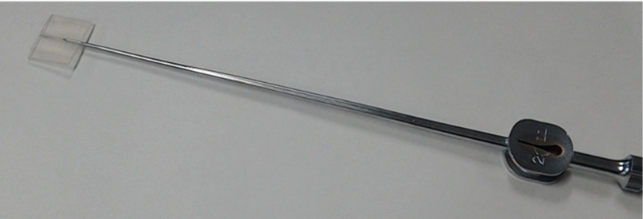
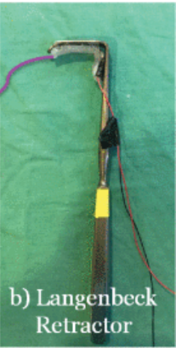
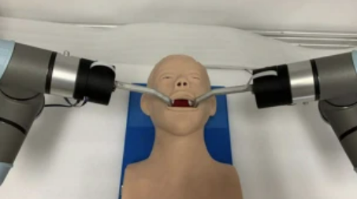
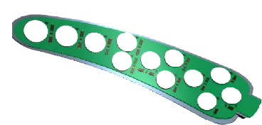
Existing Retractors with Tissue Feedback
Gap: No commercially available handheld retractor provides real-time tissue feedback in cervical spine surgery
Majority of studies are preclinical
Force-Sensing Silicone Retractor: Neurosurgery¹
Limited feedback, visual only; force range 0.1–0.7 N
Soft Tactile Hydrogel Retractor: Oral surgery²
Limited spatial resolution; cannot localize force
Transoral Robotic Surgery Force-Sensing Retractor: Oral surgery³
Limited adoption outside robotics
Limited commercial products
SmartBrain Retractor (Neuro-Kinesis): Neurosurgery⁴
Specialized; cost/adoption may limit general use

Slide 7
Stakeholders Overview
PRIMARY STAKEHOLDERS
Spine surgeons who directly use the retractor system and rely on real-time pressure feedback
Patients undergoing ACDF/ACDR, whose outcomes depend on reduced tissue injury
Operating room staff who manage device setup, sterilization, and workflow
SECONDARY STAKEHOLDERS
Hospitals and surgical centers evaluating cost, integration, and clinical benefit
Payers (Medicare, private insurers) influenced by complication rates and reimbursement pathways
Industry partners (Medtronic R&D) guiding design constraints, compatibility, and feasibility
TERTIARY STAKEHOLDERS
Regulatory bodies (FDA, ISO standards committees) overseeing safety, compliance, and approval
Device distributors and supply chain teams supporting deployment and adoption
Surgical training programs that may incorporate the technology into education

Slide 8
Design Specifications
User/Customer Need | Design Specification | Source/Evidence
Sterilizable | Maintain original device sterility; compatible with standard hospital sterilization processes | CDC Infection Control, ANSI/AAMI ST79, ISO 17665/11135
Biocompatible components | All tissue-contacting components must be medical-grade | FDA Biocompatibility Guidance, ISO 10993-1
Fail-safe operation | Retractor retains full mechanical function in the event of electronic or sensor failure | ISO 14971, IEC 60601-1
Maintain blade profile | Blade geometry and mechanical performance matches original retractors | Mentor Feedback
Battery life | System must operate continuously for > 4 hours | IEC 60601-1
Safety and Essential Performance

Slide 9
Design Specifications
User/Customer Need | Design Specification | Source/Evidence
Sterilizable | Maintain original device sterility; compatible with standard hospital sterilization processes | CDC Infection Control, ANSI/AAMI ST79, ISO 17665/11135
Biocompatible components | All tissue-contacting components must be medical-grade | FDA Biocompatibility Guidance, ISO 10993-1
Fail-safe operation | Retractor retains full mechanical function in the event of electronic or sensor failure | ISO 14971, IEC 60601-1
Maintain blade profile | Blade geometry and mechanical performance matches original retractors | Mentor Feedback
Battery life | System must operate continuously for > 4 hours | IEC 60601-1
Sensitive detection | Sensors detect forces < 0.05 N and capture the full biologically relevant range (1-10 N) | Literature Review
Real-time feedback | Continuous, low-latency (<100–200 ms) sensor updates | IEC 62366-1
Safety and Essential Performance
Functional Performance

Slide 10
Design Specifications
User/Customer Need | Design Specification | Source/Evidence
Sterilizable | Maintain original device sterility; compatible with standard hospital sterilization processes | CDC Infection Control, ANSI/AAMI ST79, ISO 17665/11135
Biocompatible components | All tissue-contacting components must be medical-grade | FDA Biocompatibility Guidance, ISO 10993-1
Fail-safe operation | Retractor retains full mechanical function in the event of electronic or sensor failure | ISO 14971, IEC 60601-1
Maintain blade profile | Blade geometry and mechanical performance matches original retractors | Mentor Feedback
Battery life | System must operate continuously for > 4 hours | IEC 60601-1
Sensitive detection | Sensors detect forces < 0.05 N and capture the full biologically relevant range (1-10 N) | Literature Review
Real-time feedback | Continuous, low-latency (<100–200 ms) sensor updates | IEC 62366-1
Compatible base components | System components attach securely to the existing reusable retractor | Mentor Feedback
Cable management | Cables routed to avoid interference with surgical field | IEC 62366-1
Ergonomics match standard retractor | Added system mass < 0.25 lb; must preserve surgeon grip and maneuverability | IEC 62366-1
Durability | Any reusable components must retain functional integrity after repeated mechanical use and sterilization cycles | IEC 60601-1
Data Security | The record of signals ensure the privacy and protection of the patient | HIPAA
Safety and Essential Performance
Functional Performance
Mechanical Integration

Slide 11
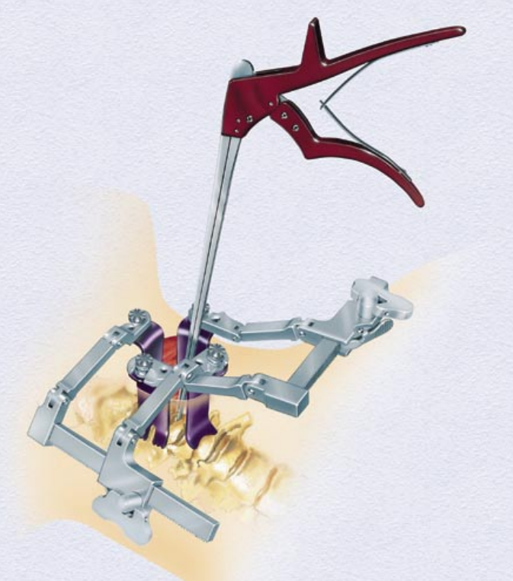

Our Solution
Candidate points for load/pressure sensing:
RETRACTOR ARM
1
Measures tensile forces transmitted through the arms as they hold the incision open.
1
2
RETRACTOR BLADE
2
Measures local pressures applied by the blades directly against surrounding tissue.
Source: Medtronic, TrimLine Anterior Cervical Discectomy & Fusion Instrument Set (2002)

Slide 12
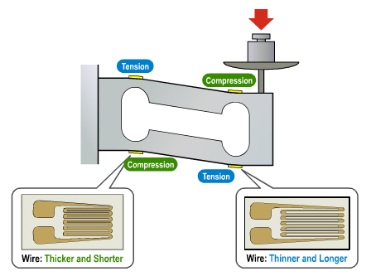
Our Solution
1
RETRACTOR ARM
1
Source: SparkFun Electronics (2025)
Source: Medtronic, TrimLine Anterior Cervical Discectomy & Fusion Instrument Set (2002)

Slide 13
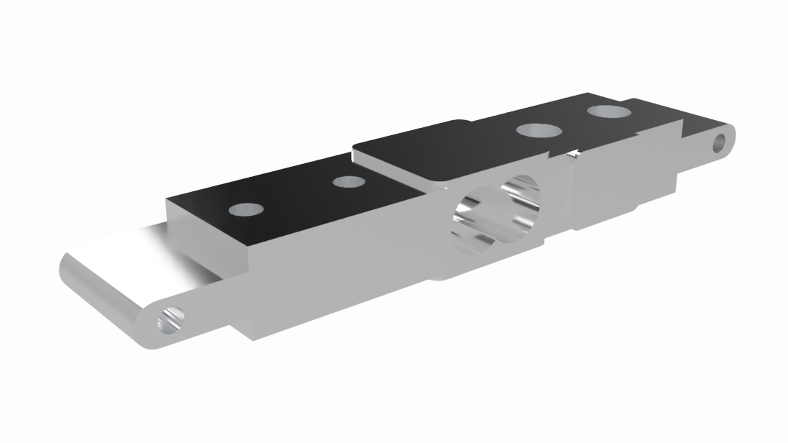
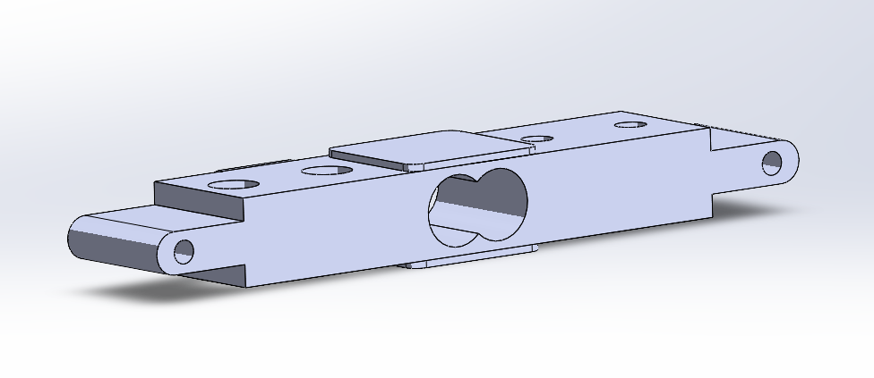
Our Solution
1
RETRACTOR ARM
1
Designed in SolidWorks
10 mm
Source: Medtronic, TrimLine Anterior Cervical Discectomy & Fusion Instrument Set (2002)

Slide 14
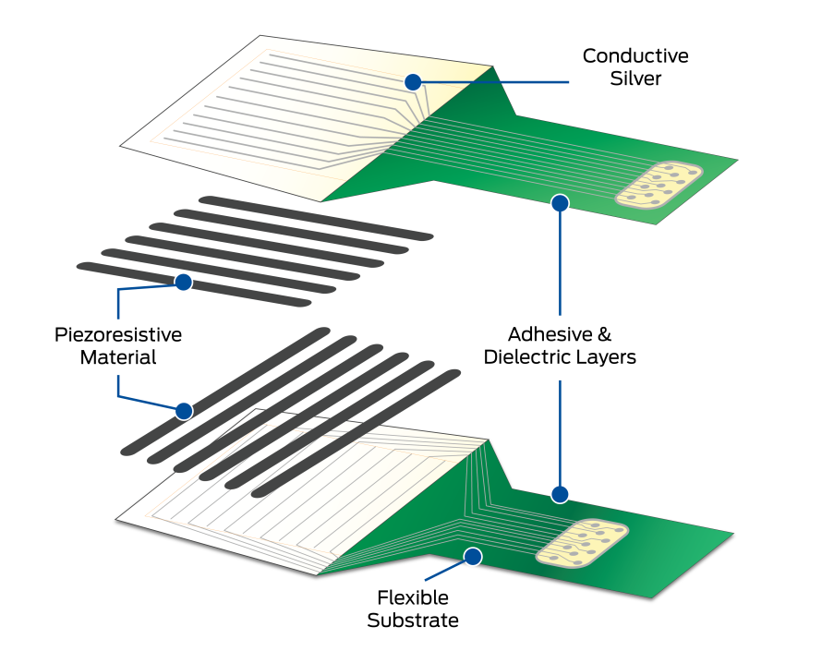
Our Solution
2
RETRACTOR BLADE
2
Source: Tekscan (2025)
Source: Medtronic, TrimLine Anterior Cervical Discectomy & Fusion Instrument Set (2002)
Notes:
Piezoresistive pressure sensor

Slide 15
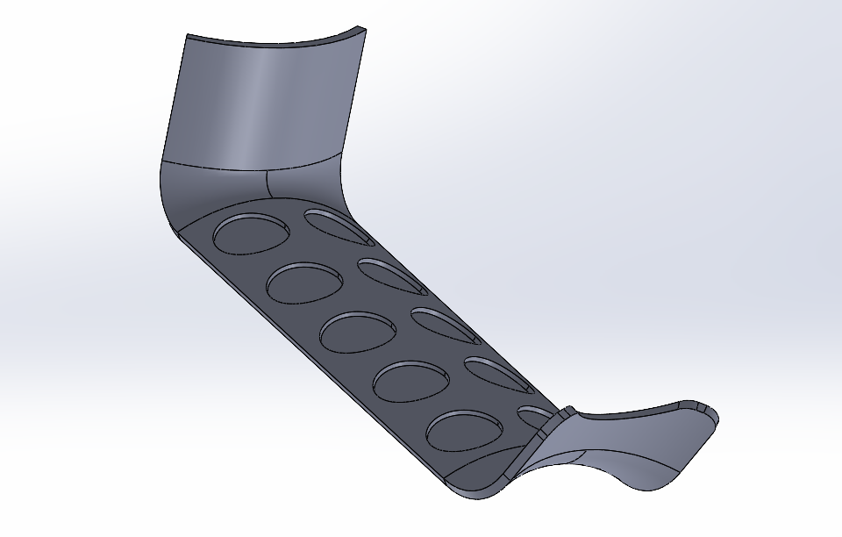
Our Solution
2
RETRACTOR BLADE
19.9 mm
2
Designed in SolidWorks
Source: Medtronic, TrimLine Anterior Cervical Discectomy & Fusion Instrument Set (2002)
Notes:
Piezoresistive pressure sensor

Slide 17
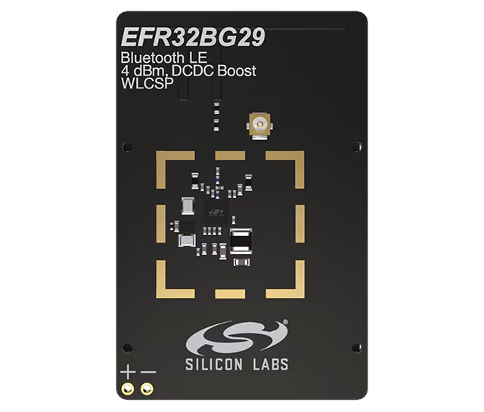

Our Solution
*[2.825mm x 2.657mm x 0.5mm]
EFR32BG29 wireless SOC
A highly efficient, high memory, low-power, and ultra compact SoC designed for secure and high-performance wireless networking.
Seamless Integration
Used in both prototypes to interface with the transducers and provide Bluetooth connectivity to the computer processing unit.
Source: Silicon Labs (2025)
Notes:
WLCSP45 Package (2.825mm x 2.657mm x 0.5mm)

Slide 18


Market Analysis Summary
In 2031, the total U.S. spinal surgery device market is projected growth to grow to 29.28 billion (~5.5 CAGR)
520 million USD in retractor systems (~10% are spinal)
30 – 35 % of spine retractors are cervical
60 – 65 % of cervical retractors are ACDF
Market Impact
Reduce time/money costs associated with complications that arise from tissue damage in ACDF surgery
Competing Solutions
None
Target Market
Surgeons and Hospitals who perform ACDF
19.08B (5.5% CAGR) US Surgical Device Market
52 Million US Spinal Retractor Market
18.56B Other surgical devices (implants, plates, screws, bone grafts, etc. )
9 - 11 Million US ACDF Retractor Market

Slide 19
Proposed Business Model
General Idea
Hospital / surgeon buys a reusable frame + uses a single use disposable blades/ load cell arm for every ACDF surgery
Revenue streams
Disposable kit: $250–$600 per ACDF
(Load cell arm and sterile blade set)
Reusable frame: $10k–$15k (one-time purchase, lasts years)
Why this works
Avoids the chance of autoclaving damaging electrical components
Provides a steady revenue stream

Slide 20
Proposed Regulatory Pathway
Proposed Procedure/Method | Test Type | Standard # | Purpose | Acceptance Criteria
Pressure sensor calibration with traceable pressure source | Bench | ASTM E74 | Ensure accuracy of pressure sensor | Accuracy within 5%
Tensile strength using mechanical tester on blade/handle alloy | Bench | ASTM E8 | Verify durability of metal materials under tension | No failure within a factor of 10 of the expected clinical load
Electrical safety of pressure sensing circuit | Bench | IEC 60601-1 | Ensure safety of patient and surgeon from electrical components | No electrical components caused harm to patient or surgeon
Simulated-use test on human cadaveric neck with pressure mapping | Bench | ISO 62366-1 | Validates device function and clinical ease before use on human or animal subjects | Full sensor functionality, no mechanical or electrical failure
Local tissue response under retraction (porcine cervical model) | Animal | ISO 10993-6 | Monitor tissue response to retraction in animal model | No significant histopathology compared to control
Limited clinical pilot | Human | ISO 14155 | Determine effectiveness of device with real human patients | No adverse effects compared to patients with normal retractors, decreased dysphonia and dysphagia symptoms post-surgically
Human factors/usability testing with surgeons | Human | IEC 62366 | Evaluate usability of device for surgeons | >95% correct response to feedback provided by device
Notes:
From a regulatory standpoint, this device aligns closely with existing Class II cervical retractors, so we will pursue an FDA 510(k) pathway. The core mechanism, tissue retraction, is unchanged, and our added biosensing functionality does not introduce new anatomical contact or new risks. Because the technological characteristics and indications for use remain equivalent to current devices, substantial equivalence supports a 510(k) submission.
To demonstrate safety and effectiveness, our testing plan includes mechanical, electrical, usability, and biological evaluation. We will have 4 bench tests followed by an animal test and then 2 tests in humans. The animal testing will ensure tissue response is accurately measured, while the limited human clinical study under ISO 14155 will confirm reduced postoperative complications and safe intraoperative use. Human-factors testing, using IEC 62366, will ensure surgeons can easily interpret the feedback and respond appropriately.

Slide 21
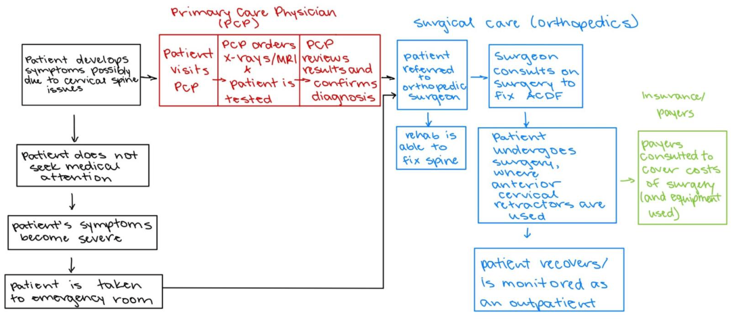
Proposed Reimbursement Pathway
Primary Payers
Hospitals, Medicare, private insurers
ACDF surgery billed under CPT 22551
Part of hospital’s per-procedure surgical kit
Seek device-specific ICD or HCPCS
Clear reimbursement pathway
Notes:
On the reimbursement side, hospitals, Medicare/Medicaid, and private insurers are the primary payers because the retractor is used in a well-established reimbursable procedure: ACDF, which is billed under CPT 22551. Because the device is single-use and disposable, it fits naturally into the supply chain as part of a hospital’s per-procedure surgical kit. Today, most retractors are reimbursed as part of bundled DRG or surgical supply payments, and we anticipate the same structure initially for our retractor attachments.
However, if clinical data show that our sensor-enabled retractors significantly reduce postoperative complications, particularly dysphagia and dysphonia, we would pursue a device-specific ICD or HCPCS code to reflect its added clinical value. Having our own code would create a clearer reimbursement pathway and further incentivize hospital adoption.

Slide 22
Future R&D Directions in Tissue Monitoring
Near-term
Integrate sensors into the ACDF retractor hardware
Iterate design around real blade geometry and attachment points
Evaluate sterilization and material compatibility
Perform benchtop testing
Mid-term
Calibrate sensors under realistic tissue loads (cadaveric or phantom models)
Test multi-sensor arrays for distributed pressure mapping
Develop a surgeon-facing interface with live feedback
Refine system usability for integration
Long-term
AI-based prediction of ischemia and nerve injury
Integrated pressure sensing platform
Fully wireless, sterile-safe hardware
Expansion to multiple surgical retractor systems

Slide 24
Thank you!
Contact Information
charlotte.d.sevrain@vanderbilt.edu
mona.gerges@vanderbilt.edu
andrew.e.blakemore@vanderbilt.edu
jason.r.beveridge@vanderbilt.edu
jacob.a.stoebner@vanderbilt.edu
camille.e.messonnier@vanderbilt.edu
Mentors
lindsey.g.waugh@medtronic.com
newt.metcalf@medtronic.com
shannon.m.vittur@medtronic.com

Slide 25
References​
Slide 1 image: https://drleespine.com.au/cervical-disc-replacement/
Slide 3 image: https://www.biospine.com/spine-procedures/minimally-invasive/anterior-cervical-discectomy-with-fusion/
Slide 4 image: https://www.londonspine.com/what-is-anterior-cervical-discectomy-and-fusion-acdf/
Existing Solutions:
[1] Watanabe, T., Koyama, T., Yoneyama, T. & Nakada, M. Force-Sensing Silicone Retractor for Attachment to Surgical Suction Pipes †. Sensors (Basel) 16, 1133 (2016).
[2] Ponraj, G., Kirthika, S. K., Lim, C. M. & Ren, H. Soft Tactile Sensors With Inkjet-Printing Conductivity and Hydrogel Biocompatibility for Retractors in Cadaveric Surgical Trials. IEEE Sensors Journal 18, 9840–9847 (2018).
[3] Zhu, L., Yang, S., Shen, J., Wang, C. & Song, A. A force-sensing retractor for robot-assisted transoral surgery. Int J CARS 17, 2001–2010 (2022).
[4] SmartBrain Retractor | Neuro-Kinesis. https://neuro-kinesis.com/technology/smart-brain-retractor/.

